Slide 1
Technical Analysis

Slide 2
Technical Analysis is one of the 3 key methods to analyse the market. (Fundamental Analysis, Technical Analysis and Sentiment Analysis.)
Technical Analysis is more prevalent in shorter term price movements, such as in trading compared to investing.
The foundation of Technical Analysis is price and its movement, unlike FA which aims to identify the intrinsic value.
Notes:
FA is what, SA is what, people are more qualified than me
TA is used more in short term, intrinsic value of FA is more suitable for investing, or swing trading.
What are the two words that economics use the most? Supply and Demand. So basically the foundation of TA is based on the observation of those forces; now you might think that it’s a bit fked up, why are you basing it upon the effect and not the cause right? But bear with me here. Again TA is all about people looking at the same signs, its kinda like in poker, instead of focusing on the probabilities, you focus on psychology instead.

Slide 3
Again, the foundation is based on price.
And this focus on price creates key levels at which people buy and sell at, that is, Support and Resistance.
Notes:
Can use mom’s example
Even big banks use it, OCBC Fx Daily Outlook

Slide 4
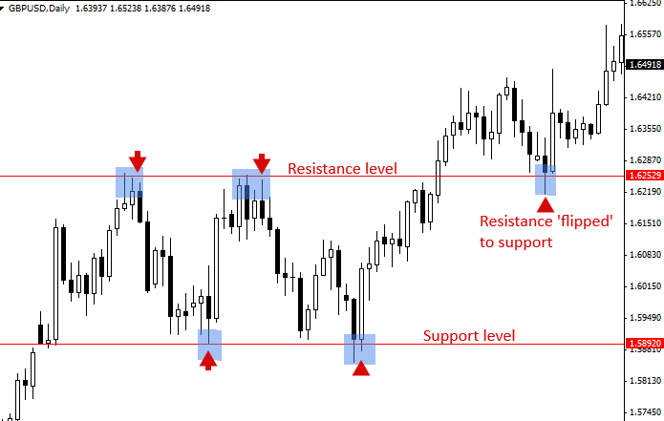
Support: A price level where a downtrend is expected to pause (due to a concentration of demand).
Resistance: A price level where an uptrend is expected to pause (due to a concentration of supply).
When resistance is broken, resistance then becomes support (vice versa for breaking of support)
Notes:
Use example of lets say apple Resistance and support Note that its not always so clear cut, it’s a zone (find examples)

Slide 5
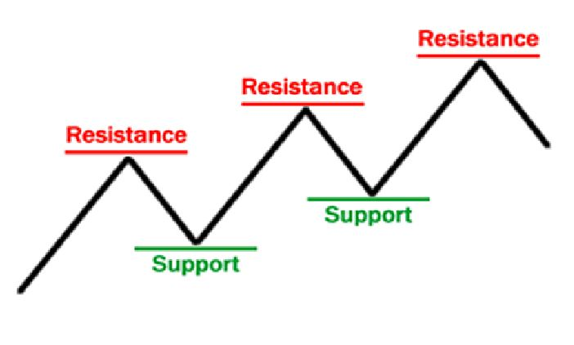
Support and resistance can be dynamic, forming trendlines.
Notes:
A break of the trendline would also signal buy/ sell This is a channel, which I will go into detail again later Just brief, too subjective

Slide 6
Essentially, there are two ways to trade S&R:
Hope it holds
Hope it breaks

Slide 7
Hope it holds: Buy (Long)/Sell (Short) at Support/Resistance
Hope it breaks: Buy/Sell at the break
Ultimately, it is still a probabilities game; this is catalysed by news, etc.
Notes:
Never know when it will hold, when it will break

Slide 8
Charts

Slide 9
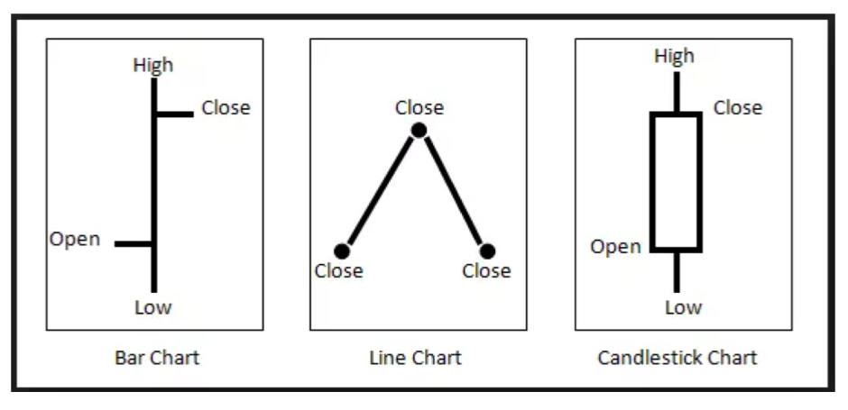
The 3 most commonly used chart types are Bar Chart, Line Chart and Candlestick Chart.
Notes:
Bar Chart: Some Angmohs like to use
Line Chart: Lesser information
Candlestick Chart: Most widely used, a lot of strategies revolve around candlestick charts, CNN (Convolutional Neural Network) should be looking to use

Slide 10
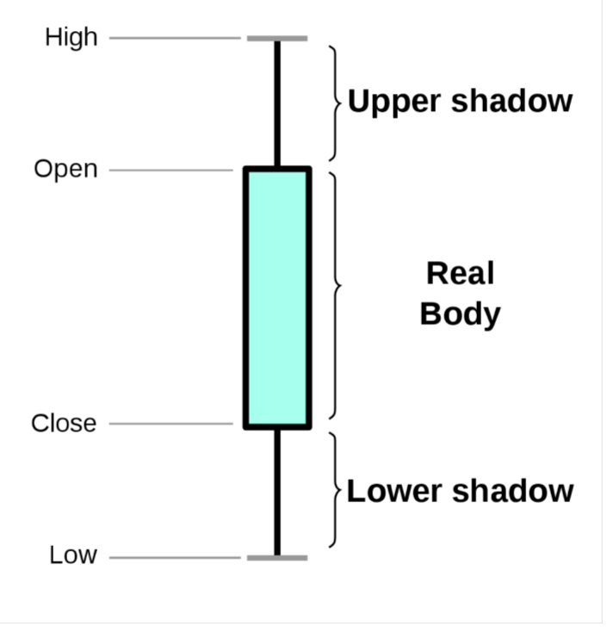
Candlesticks are often colour coded; its easy to tell at a glance whether we are in a bull or bear market.
Notes:
Candlesticks look like a boxplot
Sort of like roman numerals, you can use it if you want to
Most TA traders use candlestick charts; as such, most chart-based strategies developed are for candlesticks as well.
Tradingview

Slide 11
Candlesticks are available in different timeframes, 1 min, 2 min, 5 min, 1 hr, 4 hr, 1 day, …..
Your candlesticks timeframe depends on which type of trading you do, for scalpers it would be 1 min charts, for swing traders it could be 1 hr, 4 hr or up to a day, etc.
Notes:
Some have argued that the markets are fractals in nature.

Slide 12
Types of traders include:
1. Scalper 2. Day Trader 3. Swing Trader 4. Position Trader
Trading styles include: 1. Trend Following 2. Mean Reversion 3. Scalping 4. Arbitrage 5. High Frequency Trading
Notes:
FYI, back to candlesticks.

Slide 13
Candlestick Patterns

Slide 14
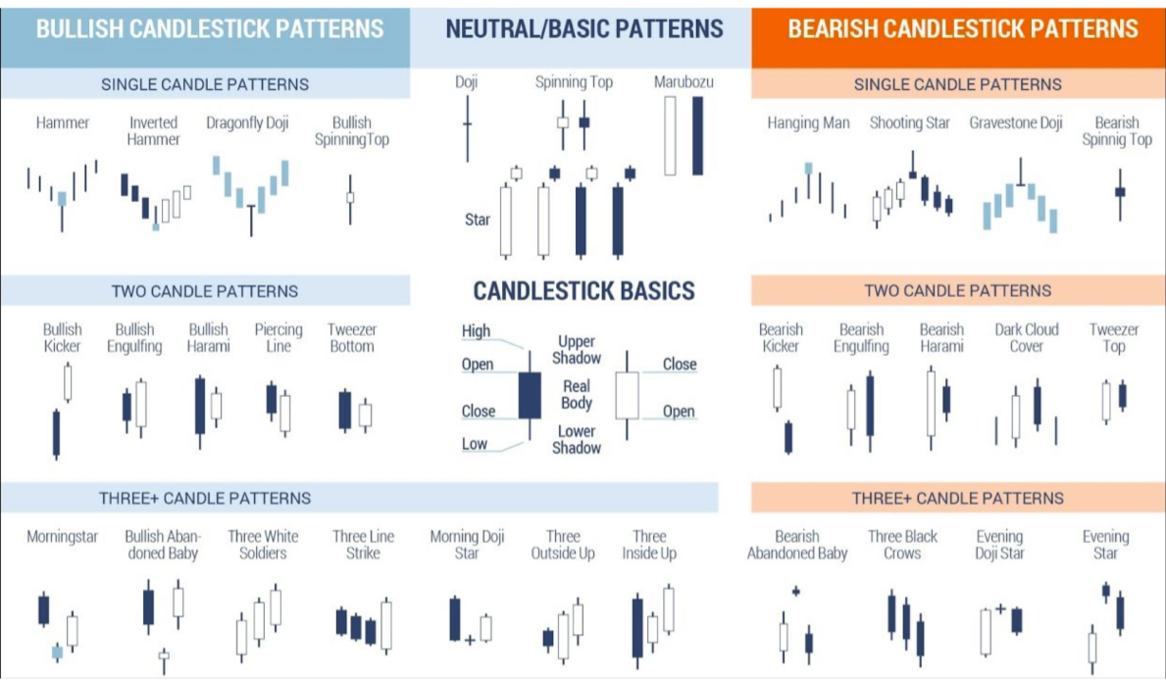

Slide 15
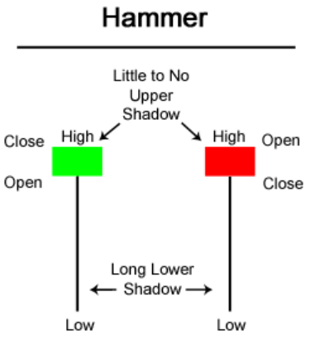
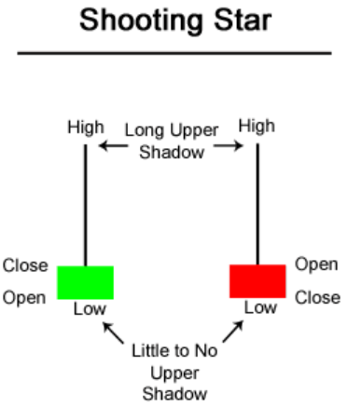
A bullish reversal pattern. Formed because bearish selling pressure lost out to bullish buying pressure.
A bearish reversal pattern. Formed because bearish selling pressure won against bullish buying pressure.

Slide 16
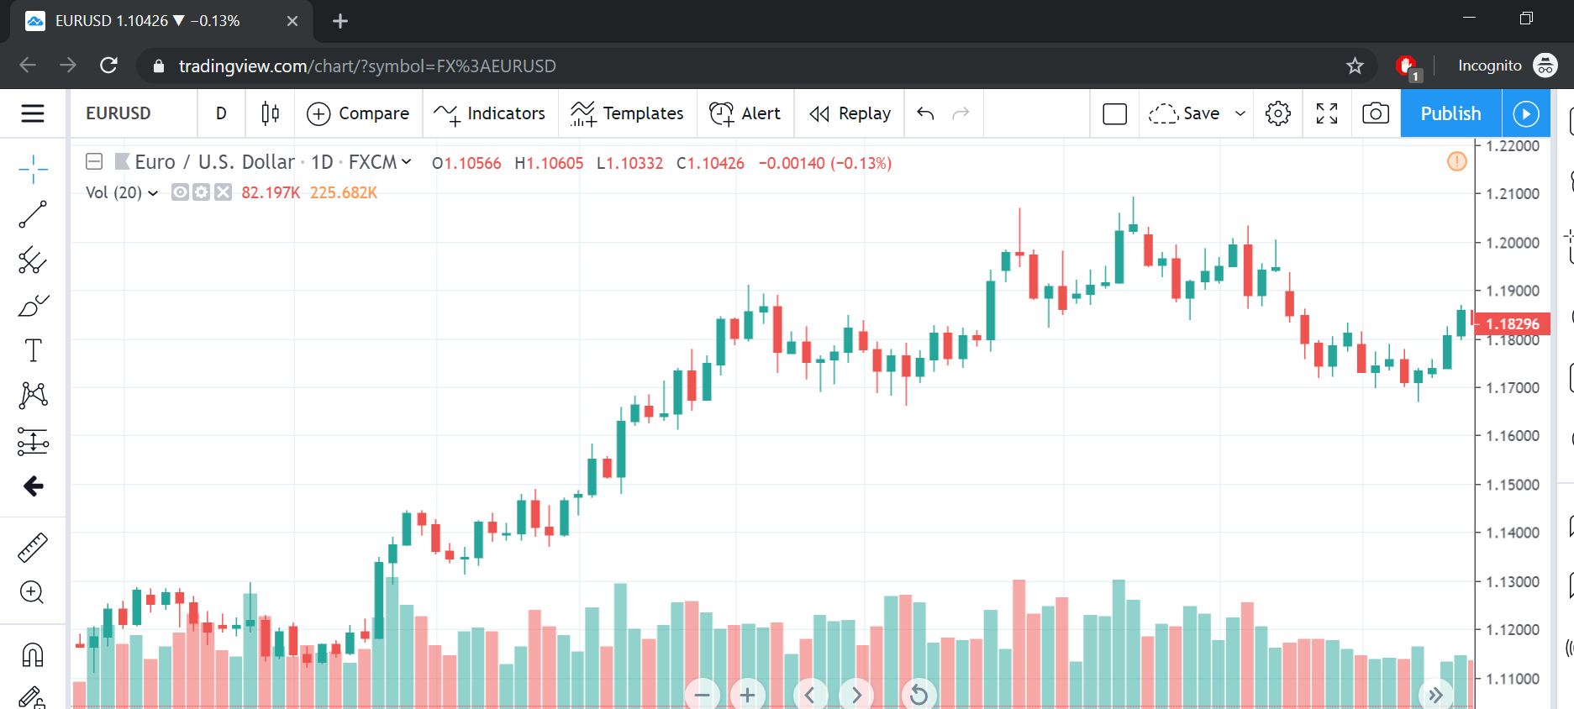
Notes:
One caveat: Wait until it finishes Note volume too

Slide 17
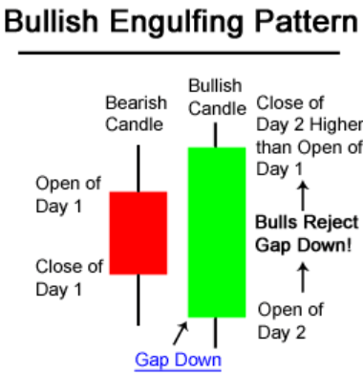
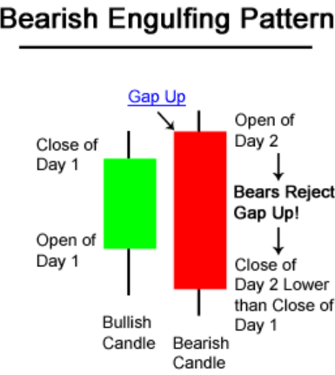
A bullish reversal pattern. Formed because bearish selling pressure lost out to bullish buying pressure.
A bearish reversal pattern. Formed because bearish selling pressure won against bullish buying pressure.
Notes:
Many bullish engulfing patterns form a hammer

Slide 18
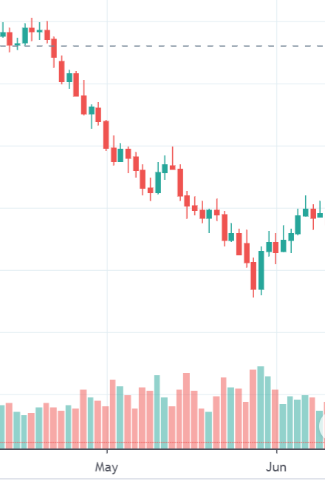
Notes:
One caveat: Wait until it finishes Note volume too

Slide 19
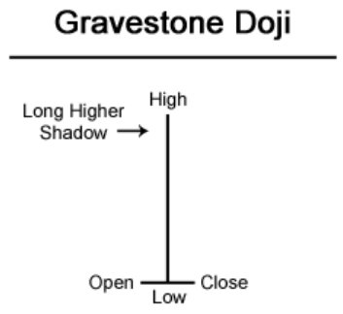
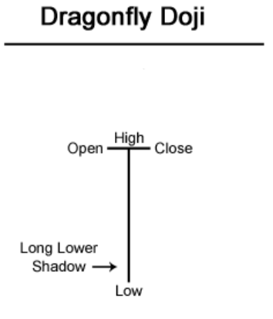
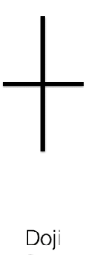
A bullish reversal pattern. Formed because bearish selling pressure lost out to bullish buying pressure.
A bearish reversal pattern. Formed because bearish selling pressure won against bullish buying pressure.
Signals hesitation.
Notes:
Tug of war Low volatility to high volatility, signals hesitation at S&R can be a sign. What are they thinking? Like poker.

Slide 20
Chart Patterns

Slide 21
Chart patterns are also used very frequently by TA traders.
However, they are even more subjective than candlestick patterns, so use them at your own discretion.

Slide 22
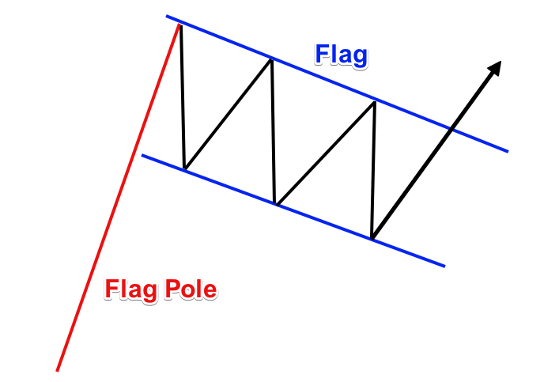
Flag: A continuation pattern, watch for breakout to enter trade.
Happens when initial price rallies sharply, then moves sideways/ slightly to the downside.

Slide 23
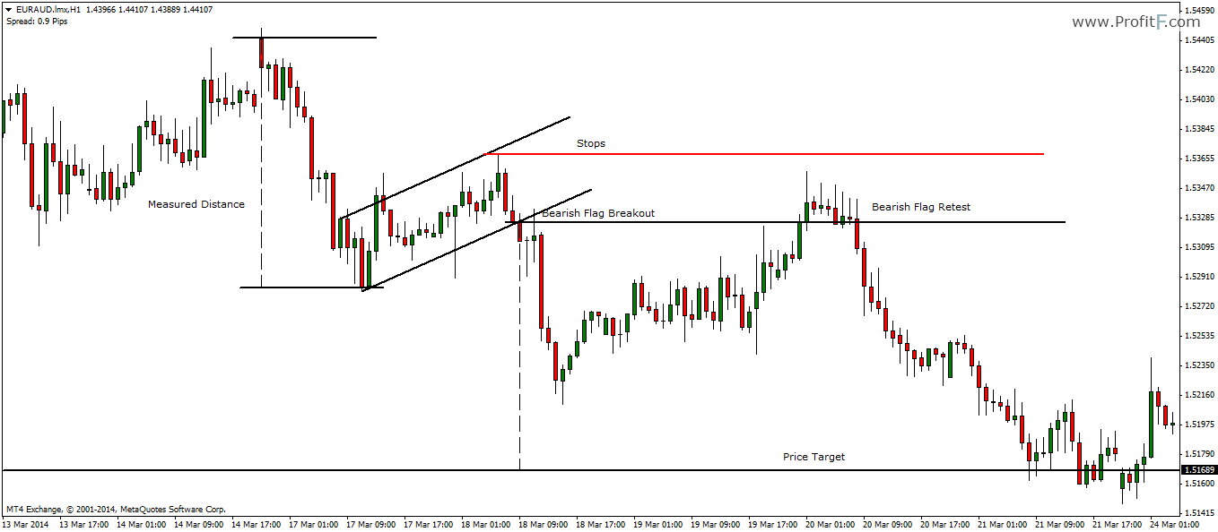

Slide 24
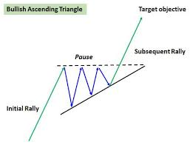
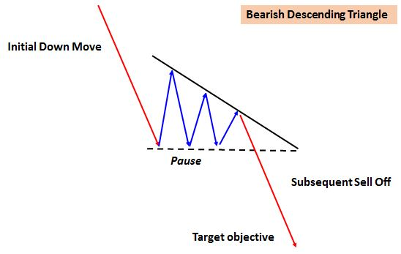
Ascending/ Descending triangle: One of the most powerful chart patterns, a continuation pattern and look for breakout.
Notes:
Squeezed, price has to go somewhere (it converges), and tug of war.

Slide 25
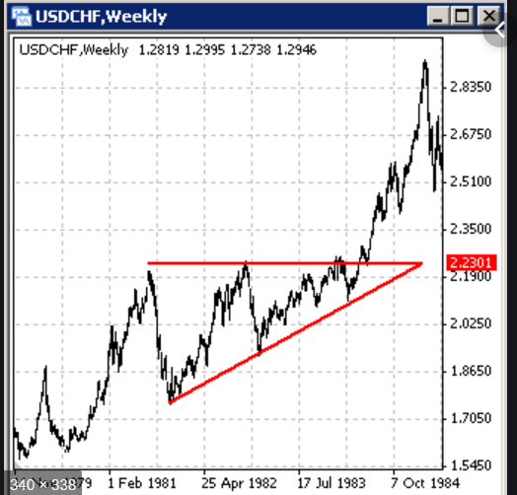

Slide 26
Indicators

Slide 27
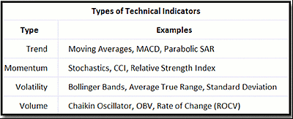
There are many types of indicators out there; experiment and find what works for you!
Notes:
Traditional trading is a very personal kind of thing, what works for me may not work for you.

Slide 28
Moving Averages

Slide 29
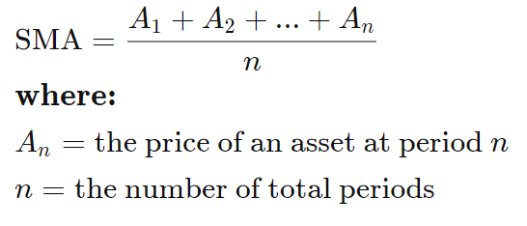
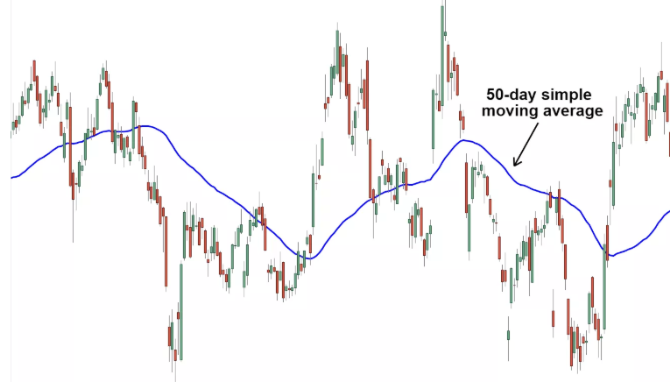
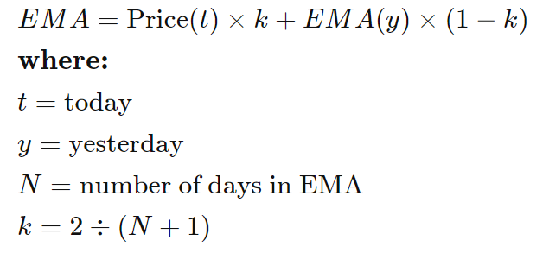
Simple Moving Averages and Exponential Moving Averages:
Most commonly used periods: 9, 20, 50, 100, 200
Two ways to use them:
As support and resistance
To find trend reversals
Notes:
EMA is basically an SMA that is weighted towards recent prices.
SMA more slow, but more well respected
EMA faster, but less respected.

Slide 30
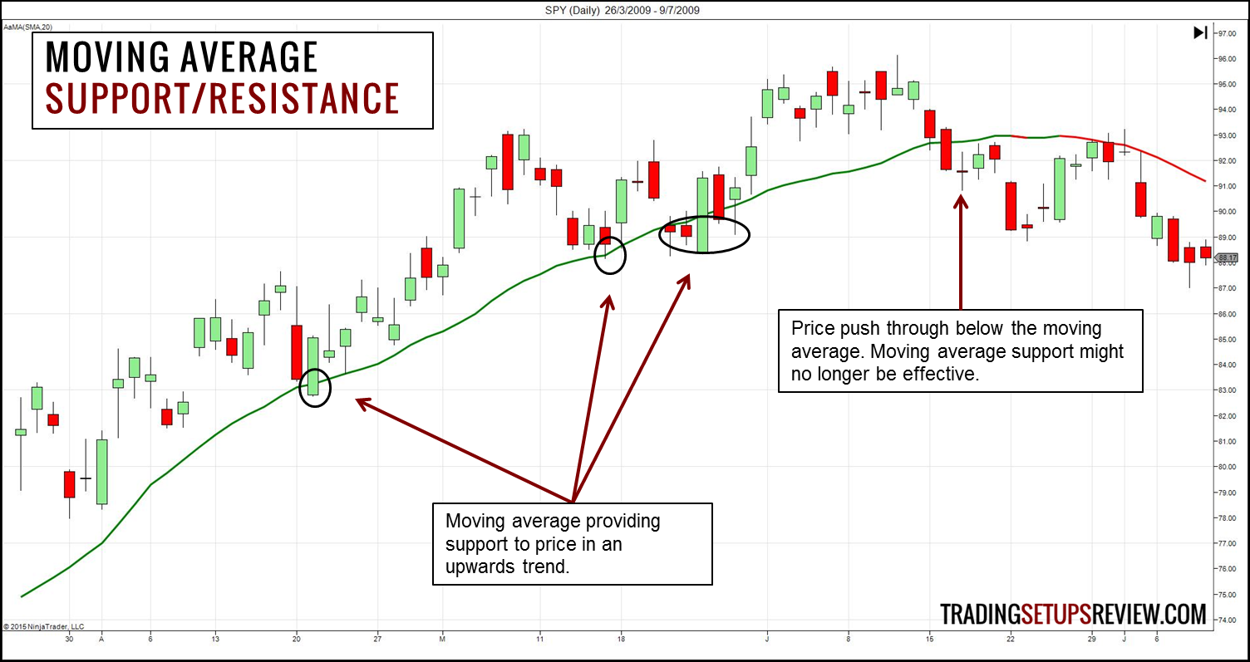
1. Moving Averages can be used as support and resistance levels. Many traders place orders at the moving averages.
Notes:
Because most people will place orders at the moving average

Slide 31
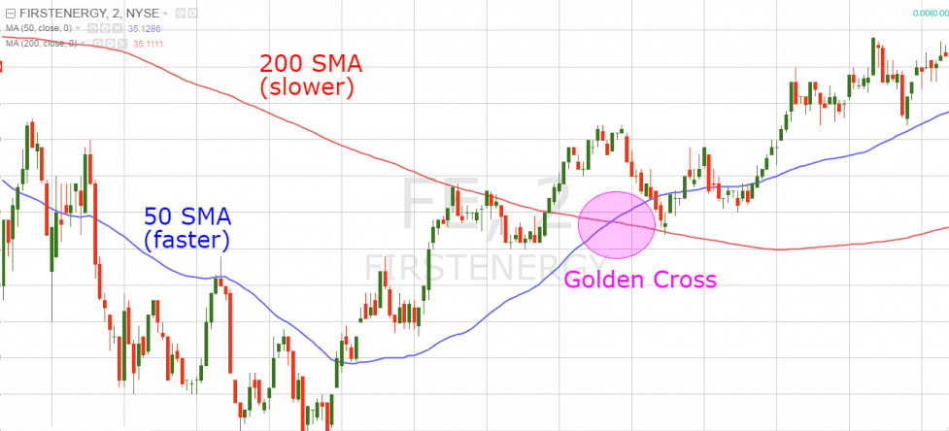
2. When MAs of different timeframes are used, a crossover signals a change in trend.
Short term cross above long term: Uptrend, buy (long) Short term cross below long term: Downtrend, sell (short)

Slide 32
Bollinger Bands

Slide 33
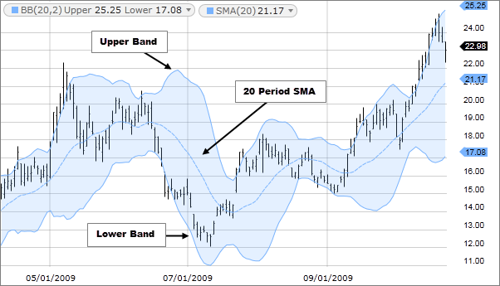
Bollinger Bands: Consists of a 20 period SMA, with an upper band and a lower band, both of which are 2 standard deviations away from the 20 SMA line. It measures volatility.
Two ways to trade BBands:
1. Mean Reversion (Ranging Market) 2. Breakouts (Trending Market)
Notes:
Ultimately is a volatility indicator. How to differentiate ranging and trending? Phi Value. Usually is experience.

Slide 34
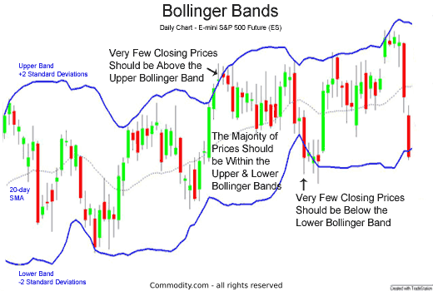
1. Mean Reversion: Long when price closes beneath lower band, short when price closes above upper band.
Notes:
Technically is a rare occurrence (Empirical rule: 95%, Chebyshev’s rule: 75%).

Slide 35
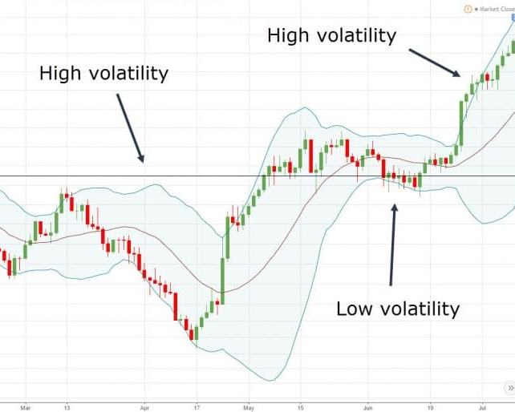
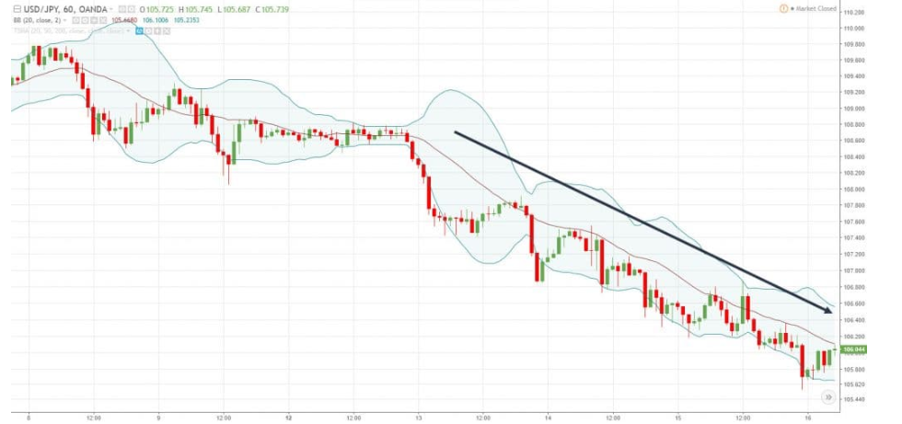
2. Breakout Trading (Bollinger Squeeze): Markets move from periods of high volatility to low volatility, long when closing price above BBands after period of low volatility.
Notes:
Bullish engulfing

Slide 36
1, 1, 2, 3, 5, 8, ….

Slide 37
Fibonacci Retracement Levels

Slide 38
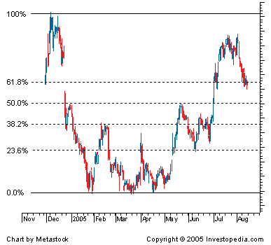
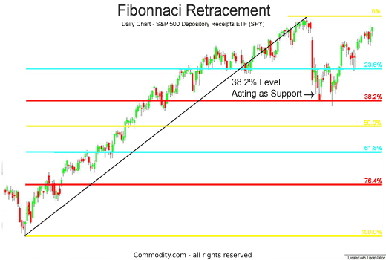
Fibonacci Retracement Levels: Aims to predict when a pullback will occur.
The levels act as potential support and resistance which helps to identify said pullback; the strongest levels are 61.8% and 38.2%.
Notes:
Market moves in waves.

Slide 39
Others

Slide 40
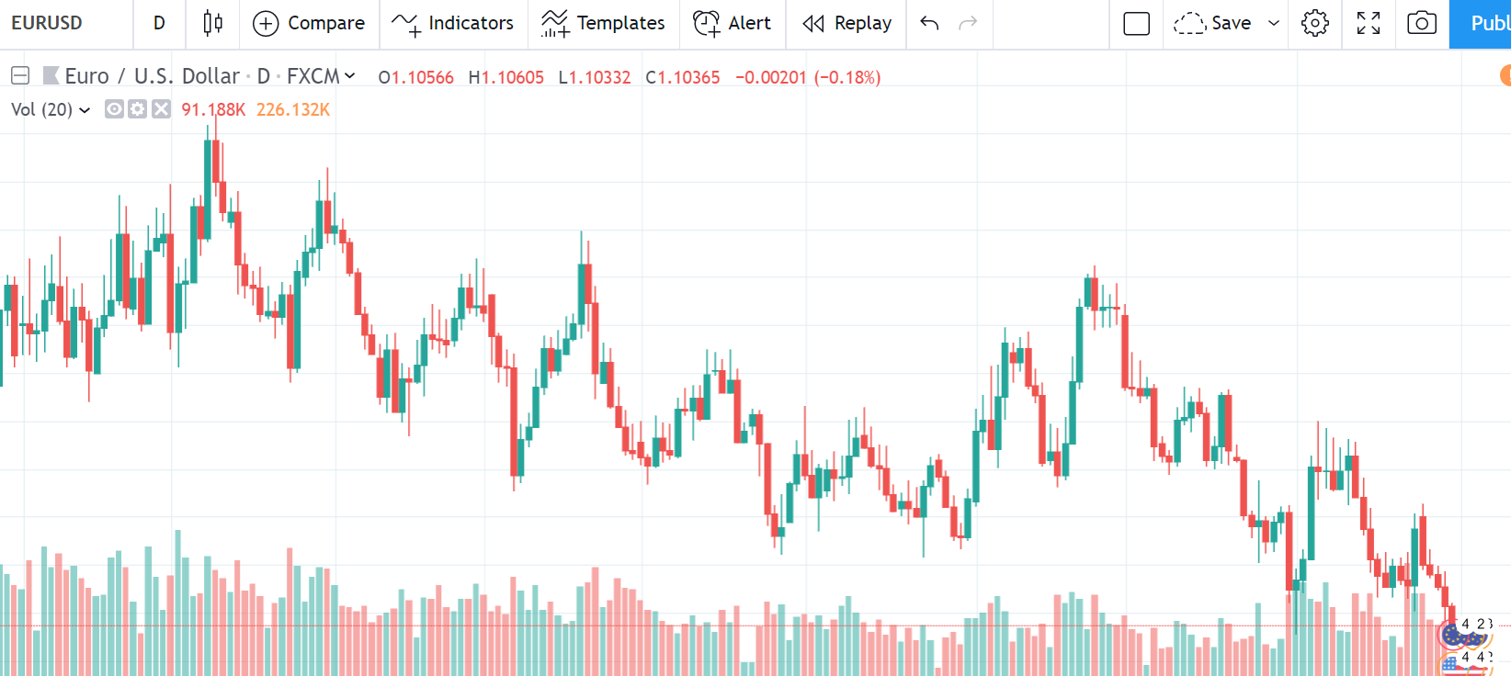
Volume: Arguably the most important indicator.
Measures interest, and strength of an observation.
Notes:
Can be strength of volume , or particular candlestick as previously mentioned (hammer and stuff).

Slide 41
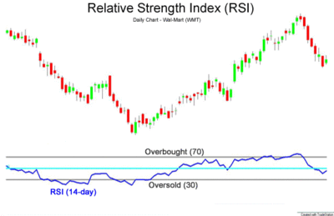
Relative Strength Index: Oversold and Overbought levels
Basically, long when oversold and short when overbought.
Notes:
When ranges, it can pullback
When downtrend, likely to stay in the oversold range.

Slide 42
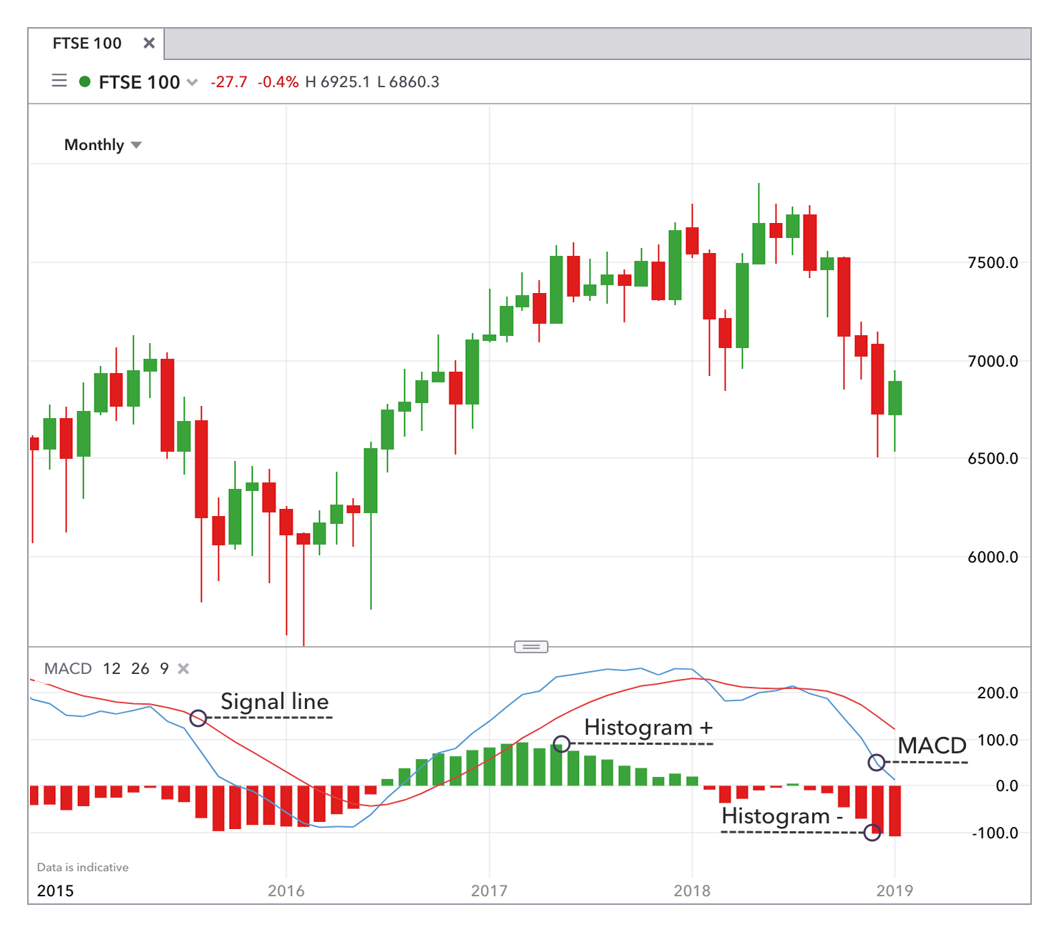
Moving Average Convergence Divergence (MACD): Trend indicator, signals a reversal in trend.
3 values, 26 EMA, 12 EMA and 9 EMA (signal line).
Notes:
When ranges, it can pullback
When downtrend, likely to stay in the oversold range.

Slide 43
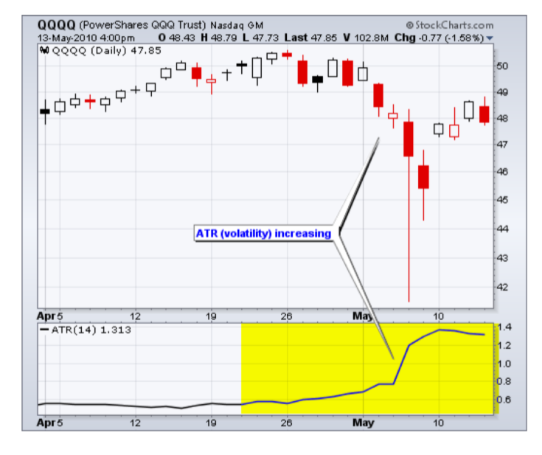
Average True Range (ATR): Measure of volatility. Higher volatility means larger change in price.
Can be used to set stop losses.
Notes:
When ranges, it can pullback
When downtrend, likely to stay in the oversold range.

Slide 44
Important Concepts

Slide 45
The market moves in cycles; retracements are going to occur.
2. Markets go from periods of high volatility to low volatility.
3. Markets are fractal in nature, double check on longer time frame charts to confirm a particular trend.
4. Technical Analysis is a self-fulfilling prophecy.

Slide 46
Questions?

